Slide 1
Road lighting design by means of genetic algorithm
Rudolf Bayer
Michal Brejcha
Zuzana Pelánová
Jan Zálešák

Slide 2
Project goals
Road lighting design for lighting situation C1 and lighting class S4
Meeting requirements of standards:
  Maintained average horizontal illuminance
  Minimum maintained illuminance
  Uniformity – given by maximal illumiance

Slide 3
Input variables
Dx - distance between pillars
Dy - sidewalk lamp overlap
Z - pillar high
α – lamp tilt
Single-side vs. two-side lamp placement

Slide 4
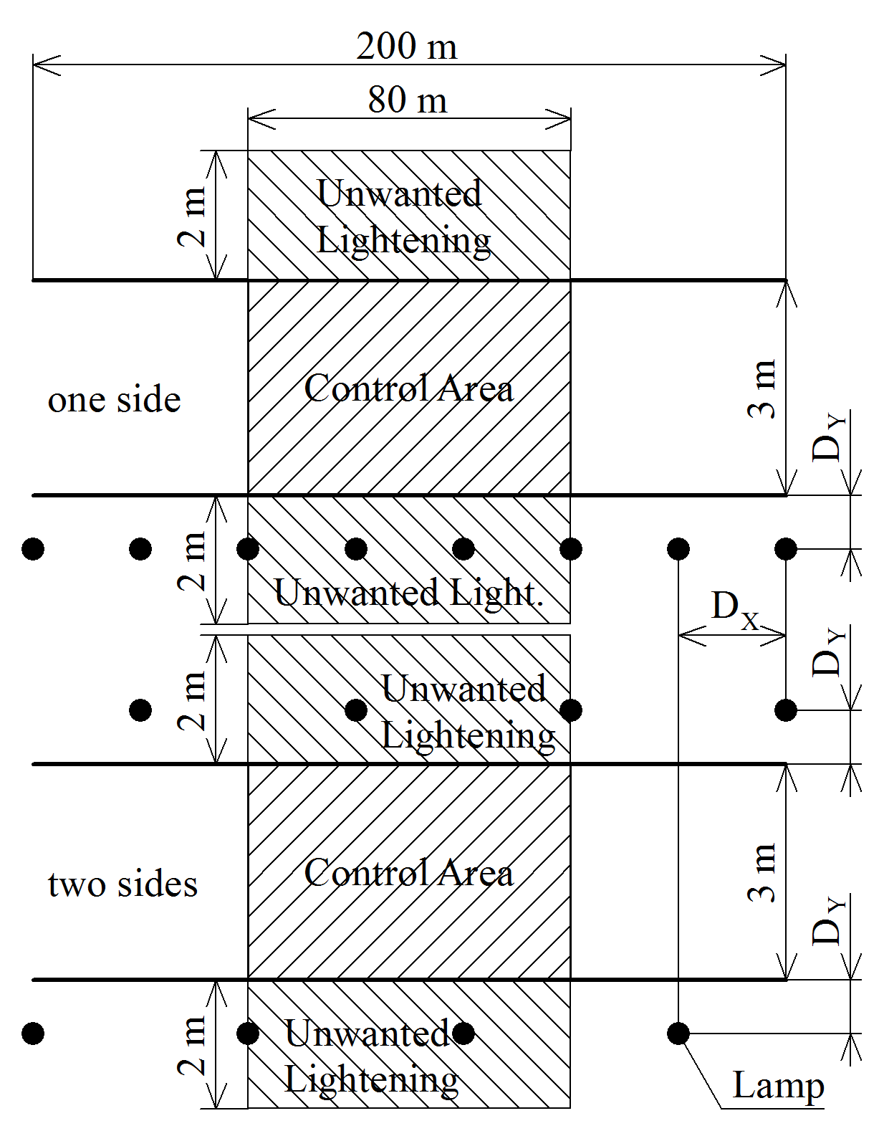
Situational overview
Dimensions:
total sidewalk length 200 m
sidewalk width 3 m
control area length 80 m
unwanted lighting area width 2 m

Slide 5
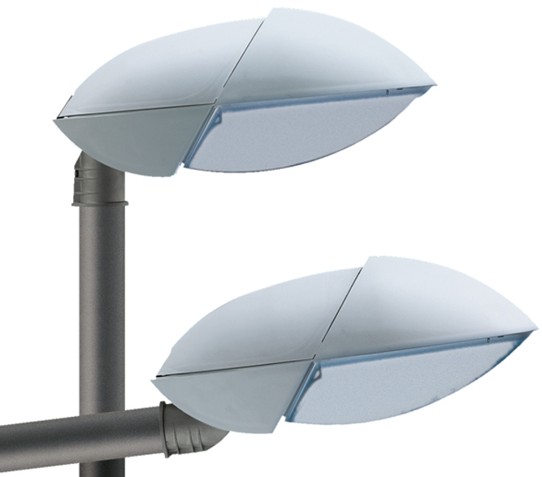
Used luminaires
Schréder Atos types A1 – A4, B1 – B4, C1 – C4
Power consumption 50 W to 150 W
Designed for pedestrian zones, cycleways, emergency lanes, etc.

Slide 6
Optimalization method
A genetic algorithm has been used using Matlab
Output data validity has been confirmed by comparison with Dialux output

Slide 7
Genetic algorithm settings
Amount of generations: 60
Population elements: 200
Crossover probability: 80 %
Mutation probability: 5 %
Parent selection: roulette

Slide 8

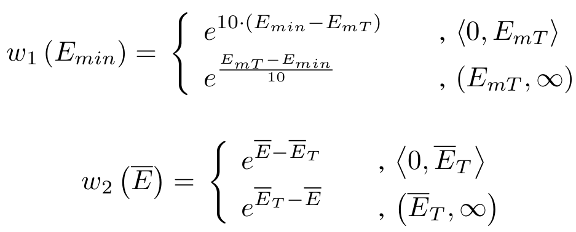
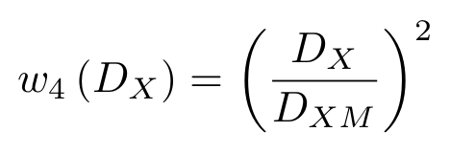
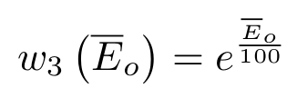
Fitness function

Slide 9
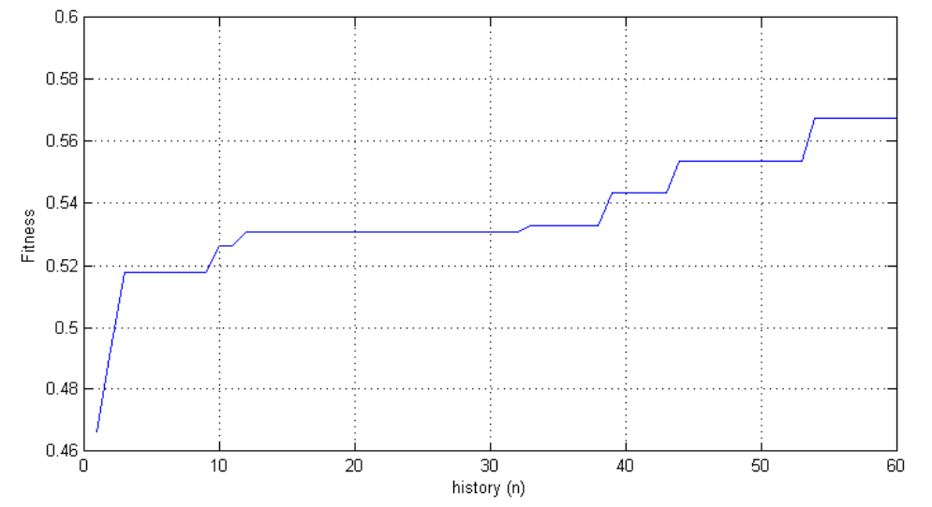
Fitness function curve during optimization

Slide 10
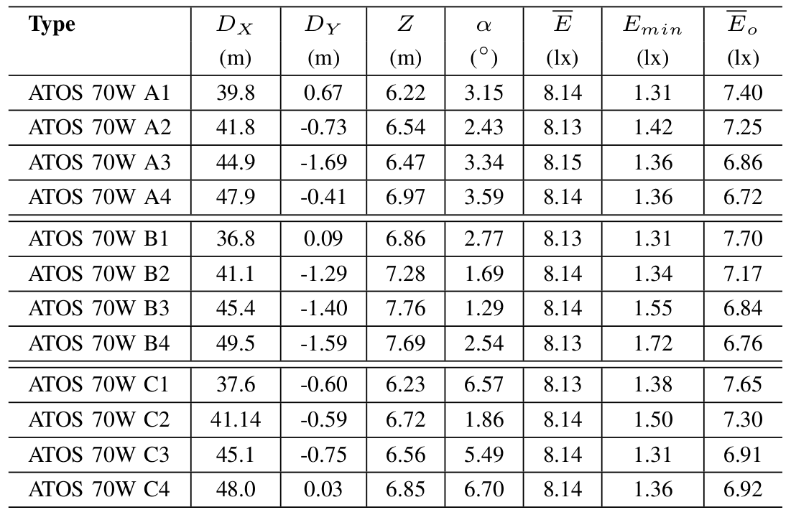
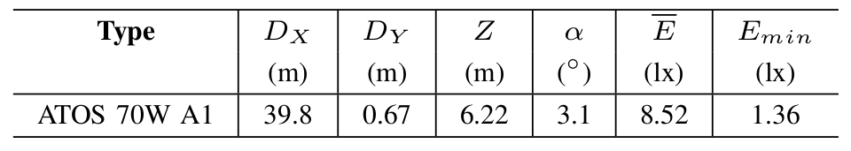
Optimization results

Slide 11
Conclusions
After a few generations an optimal solution could be found (60 generations).
All GA end results were close to results calculated by DIALux and are satisfactory in terms of the required standards.
The given requirements can be met by multiple solutions. Finding specific solutions can be accomplished by adjusting the fitness function.

Slide 12
Thank you for your attention

